Slide 1


Slide 2
Studio for Teaching and Learning

Slide 3

Studio for Teaching and Learning
New Relationships
Learning Approaches
Opportunities for students and staff

Slide 4

Studio for Teaching and Learning
Research new ideas
Explore new methods of delivery
Use technology in novel and innovative ways

Slide 5

Studio for Teaching and Learning
Explore new technologies
Gamify learning
Share our experiences beyond NSI borders
Encourage entrepreneurship

Slide 6
Studio for Teaching and Learning

Slide 7
STL
“…to act as a hub for innovative research, creative thinking and applications…where staff, students, industry and local community can share ideas, build cross-connections and develop innovative solutions to their collaboratively–defined education problems”
Macquarie University’s Education Studio Mission Statement

Slide 8
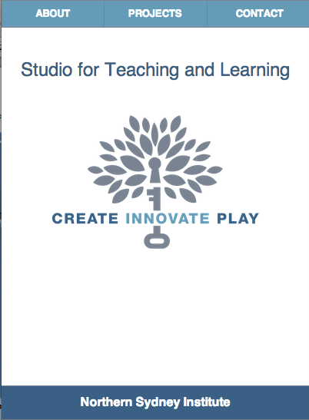

STL
COLLABORATIVE LEARNING APPROACHES
RESEARCH
STUDENT BUSINESS SPACE

Slide 9
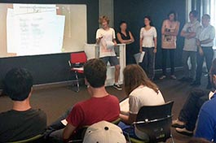
STL Projects
COMBINED GAMING/MARKETING CLASS
STUDENTS GIVEN A BRIEF AND WORKED TOGETHER TO DESIGN AND PITCH MOBILE GAME SOLUTIONS

Slide 10

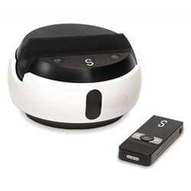
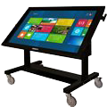
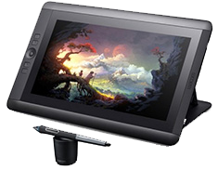
STL Projects
EXPERIMENTING WITH NEW TECHNOLOGIES, INTERACTIVE DISPLAYS, 3D PRINTING

Slide 11
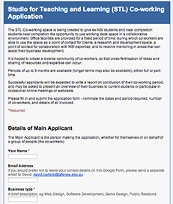
STL Projects
OPPORTUNITY FOR STUDENT BUSINESSES:
SPACE FOR A FIXED TIME
MENTORING OPPORTUNITIES
COLLABORATION WITH EXISTING STUDENTS
POSSIBLE INTERNSHIPS WITH LOCAL CO-WORKING HUB

Slide 12
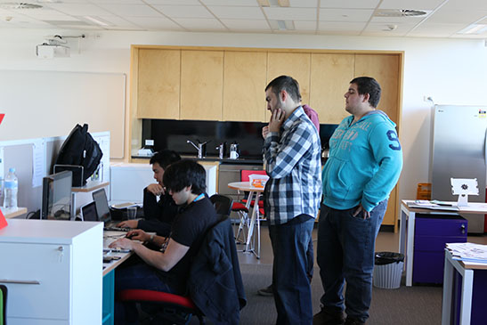
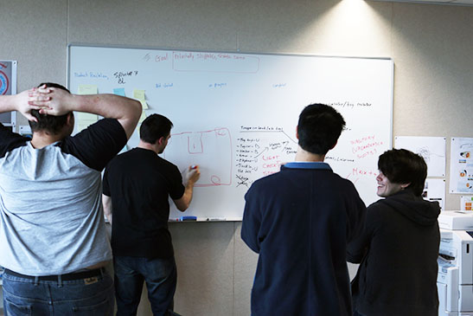
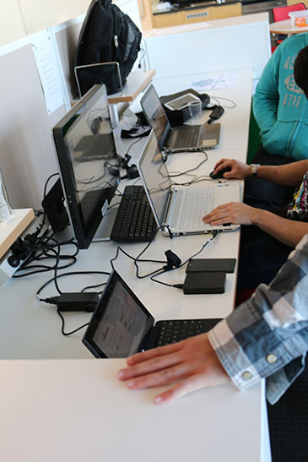
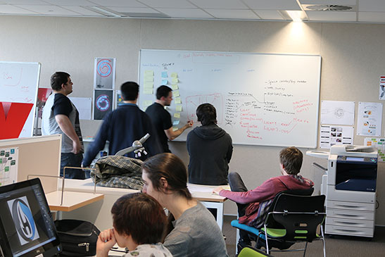
STL Projects
OPPORTUNITY FOR STUDENT BUSINESSES:
SPACE FOR A FIXED TIME
MENTORING OPPORTUNITIES
COLLABORATION WITH EXISTING STUDENTS
POSSIBLE INTERNSHIPS WITH LOCAL CO-WORKING HUB

Slide 13

STL Projects
JOINT RESEARCH PROJECT WITH MACQUARIE UNIVERSITY’S EDUCATION STUDIO LOOKING AT CROSS-SILO COLLABORATION AND STUDENT WORK-INTEGRATED-LEARNING APPROACHES

Slide 14
Studio for Teaching and Learning
Thank you

